Slide 1

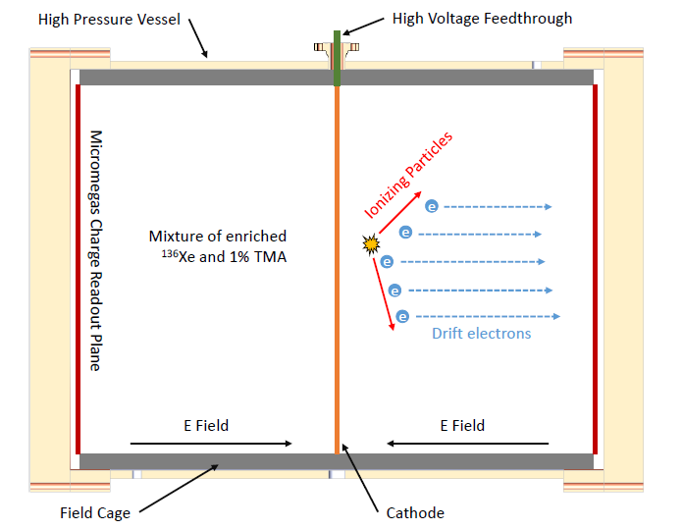
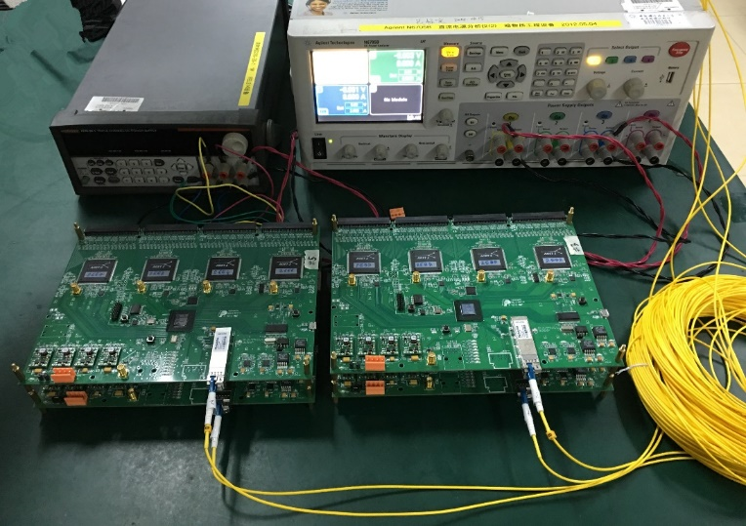
Design of the FPGA-based Gigabit Serial Link for PandaX-III Experiment
Cheng Li, Changqing Feng, Jianing Dong, Danyang Zhu, Shubin Liu, Qi An
State Key Laboratory of Particle Detection and Electronics, University of Science and Technology of China, Hefei City, Anhui Province, China
1. Introduction
To reduce trigger latency and simplify data processing, we developed a user defined protocol based on GTX. GTX interface in the FPGA is employed as a bridge between high speed serial data and low speed parallel data. To reduce bit error probability, 8B/10B encoding is utilized in GTX. We use the high 8 bits as the header of data package when 2-bit charisk set as 01. In this way, different type of data are encoded in this simple protocol. A prototype small-scale TPC equipped with 7 micromegas modules is built for prototype verification. A readout electronic system for this prototype TPC has been put forward, comprising of 4 FECs, 1 MRC and 1 DAQ. Fig. 3 shows the block diagram of TPC prototype readout electronic system. A photograph of DAQ is illustrated in Fig. 4. It is equipped with 6 optical fiber transceivers for communication with FEC and MRC, 1 optical fiber Ethernet transceiver to provide a single 1 Gbps Ethernet interface to PC, and a powerful FPGA with DDR3 memory.
Particle And Astrophysical Xenon Experiment III (PandaX-III) is the neutrino-less double beta decay detection experiment in China Jin Ping underground Laboratory (CJPL), aims to search Neutrinoless Double Beta Decay (NLDBD) of high pressure 136Xe gas in Time Projection Chamber (TPC). This experiment targeting to discover the rare nuclear weak-decay could uncover the possible Majorana nature of neutrinos, thus would be an important breakthrough in fundamental physics. The gas TPC technology for NLDBD provides high energy resolution and the capability of track detection, which is critical for identifying NLDBD events. Fig.1 shows the schematic of PandaX-III TPC. Its length is about 2 m and diameter is about 1.5 m. The field cage is made of radio-pure material and 10 bar of 136Xe gas is enclosed in it. Each TPC end-plate is composed of 41 micromegas detectors, each read out in 64 X and 64 Y strips. Anode strip signals and mesh signals are read respectively by front-end cards (FECs) and mesh readout cards (MRCs). In order to minimize pickup noise on the raw analog electronics, these readout boards are placed close to detectors. Digitized signal data of front-end electronics needs to be transferred back to trigger and data concentration modules (TDCMs), and then to PC farm running software. One critical requirement of this readout scheme is to design an appropriate link between electronics, which needs high throughput, low material, water proof and robustness. This paper describes the design of gigabit optical fiber link for PandaX-III TPC.
Fig. 3. Readout electronics system for PandaX-III prototype TPC.
Fig. 4. Photograph of DAQ.
4. Performance
Fig. 1. Schematic of the PandaX-III TPC.
To confirm the validation and stability of data communication between FEC and DAQ, two tests are conducted: eye diagram measurement and Bit Error (BER) test. The eye diagram is measured using differential probe TDP3500 of 3.5 GHz bandwidth and Tektronik oscilloscope DPO7354C of 3.5 GHz bandwidth and 40 Gsps sampling rate. The test result is indicates good timing margin. To conduct BER test, we firstly employ Xilinx IP core IBERT, which is used to generate Pseudo-random Binary Sequence (PRBS) and detect received sequence. Test result shows BER lower than 1x10-13. Then we use FPGA logic test transmission quality. DAQ needs to generate RPBS7 (one industry / telecom widely used PRBS pattern) and sends it through optical fiber to FEC. FPGA on FEC detects the received data and compares it with local PRBS7 data. Test was conducted over 24 hours continuously, and no error is detected. We can conclude that BER is lower than 1x10-13.
Finally, a joint test of 4 FECs and 1 DAQ connected via optical fiber is conducted. Commands are send from PC via gigabit Ethernet port and then fanout through DAQ to FEC. Valid data from 4 FECs are sent back to DAQ, and then read out through gigabit Ethernet back to PC using TCP/IP. Also the function of clock and trigger is tested. This prototype system proves our design is suitable for PandaX-III experiment readout. Joint test of this readout system together with prototype TPC is to be done in the near future.
2. Requirement of Serial data Transmission
Fig. 2 is the photograph of FEC. Each FEC contains 4 ASIC chip AGET, each in charge of amplifying, shaping and 512 analog sampling for 64 channels. Besides, a discriminator for multiplicity building and self-trigger is provided in it. Sampled analog signals from AGET will be digitized by an ADC, and then the digitized waveform is processed in an on-board FPGA, and finally sent back through optical fiber. The optical fiber link realizes 1 Gigabit data rate, providing sufficient spare bandwidth for FEC data transmission. To realize a complete 3D track reconstruction using TPC end-plate Micromegas modules, synchronizing clock and trigger of all micromegas modules for each end-plate is necessary. FECs recover clock using serial data from back-end and generate clocks for ADCs and AGETs. Triggers could be generated by FEC AGET chips (we call it self-trigger), and generated by MRC board (we call it mesh-trigger). Finally, this trigger is fanout through optical fiber.
Channel: comparsion | Strip: position
CH1>CH2 | Strip 1
CH2>CH3 | Strip 2
CH3>CH1 | Strip 3
CH1>CH3 | Strip 4
CH3>CH2 | Strip 5
CH2>CH1 | Strip 6
Fig. 5. A photograph of the test platform of 4 FECs connected with DAQ board via optical fiber.
Fig. 2. Photograph of FEC.
5. Conclusion
3. Gigabit Serial Link Realizing
This paper analysis the background and requirement of designing a gigabit serial link using a single optical fiber in PandaX-III experiment. This link needs to send synchronous clock and trigger, commands and raw data simultaneously. We built a small prototype readout system and tested the performance of our design. Test results show the communication functions well and its quality is assured.
This work was supported by the Strategic Priority Research Program on Space Science of Chinese Academy of Sciences (Grant No. XDA04040202-4), and the National Basic Research Program (973 Program) of China (Grant No. 2010CB833002).
To implement gigabit serial link that satisfies requirements of sending synchronous clock and trigger, configuration commands and raw data simultaneously, a data acquisition board (DAQ) is designed for prototype validation. On this board, 1 Gbps bidirectional small form-factor pluggable (SFP) fiber transceiver transforms optical signal to serial data, and then this high-speed serial data is sent to gigabit transceiver of FPGA. Two type of serial transceiver ports of FPGA: GTP and GTX, are used respectively in Xilinx Artix-7 FPGA on FEC and MRC, and Xilinx Kintex-7 FPGA on DAQ. In order to synchronise data from different FECs, clock correction and elastic buffers inherent in GTX are used.
Author e-mail: licheng8@mail.ustc.edu.cn Technology and Instrumentation in Particle Physics 2017

